Slide 1
Forecasting Hospital Bed Occupancy
A Comparative Analysis of Time Series Models
CSCI E-116: Dynamic Modeling and Forecasting in Big Data
Harvard University Extension School
December 2025

Slide 2
The Hospital Capacity Challenge
⚠️ Understaffing Risks
💰 Overstaffing Costs
• Patient safety concerns
• Staff burnout
• Quality of care issues
• ~25% of operating budget is nursing
• Resource inefficiency
• Budget strain
COVID-19 exposed critical gaps in capacity forecasting

Slide 3
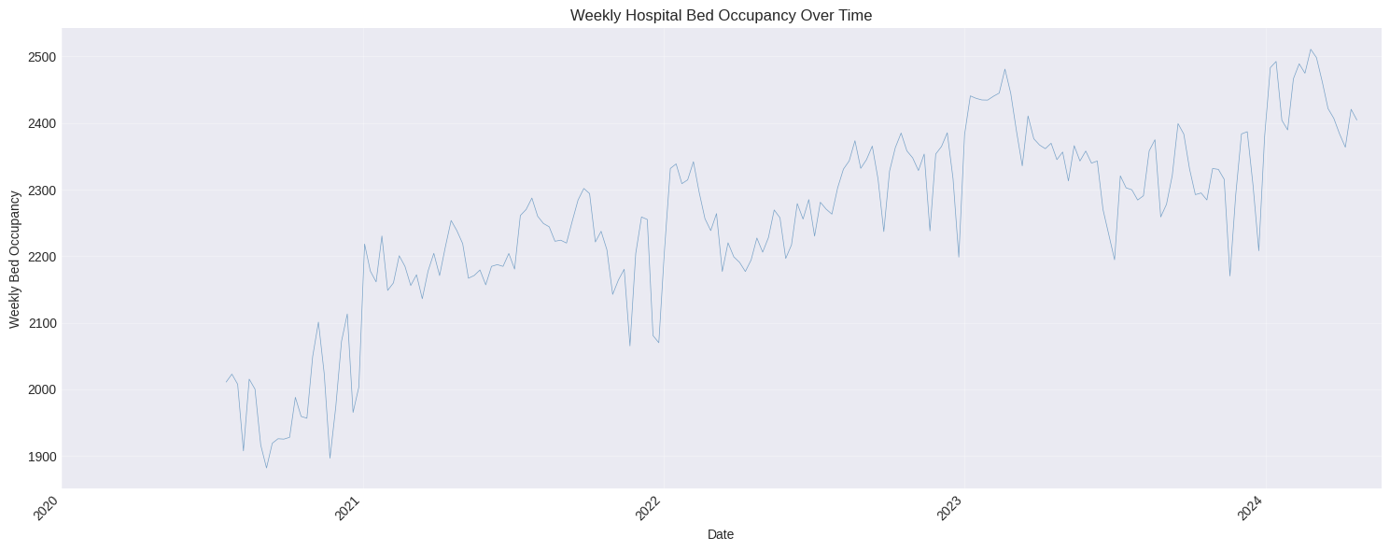
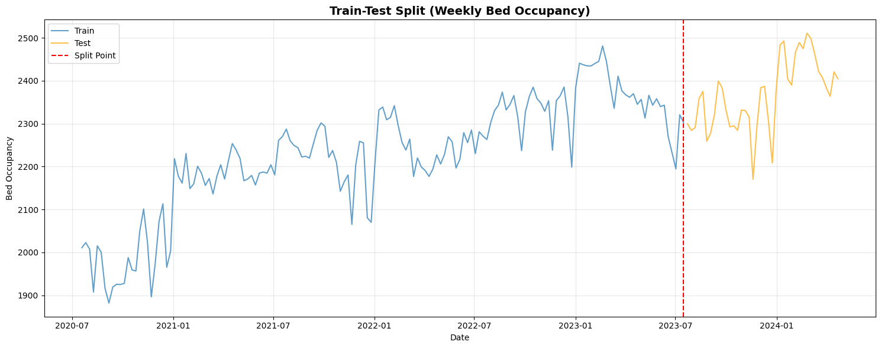
AdventHealth Orlando: 197 Weeks of Data
197
~2,254
Weekly
weeks of data (July 2020 – April 2024)
average bed occupancy
frequency
Data Sources
Source | Data
HHS | Hospital bed occupancy
CDC | Flu rates (ILI)
NOAA | Weather (temperature)
[Insert Time Series Plot]

Slide 4
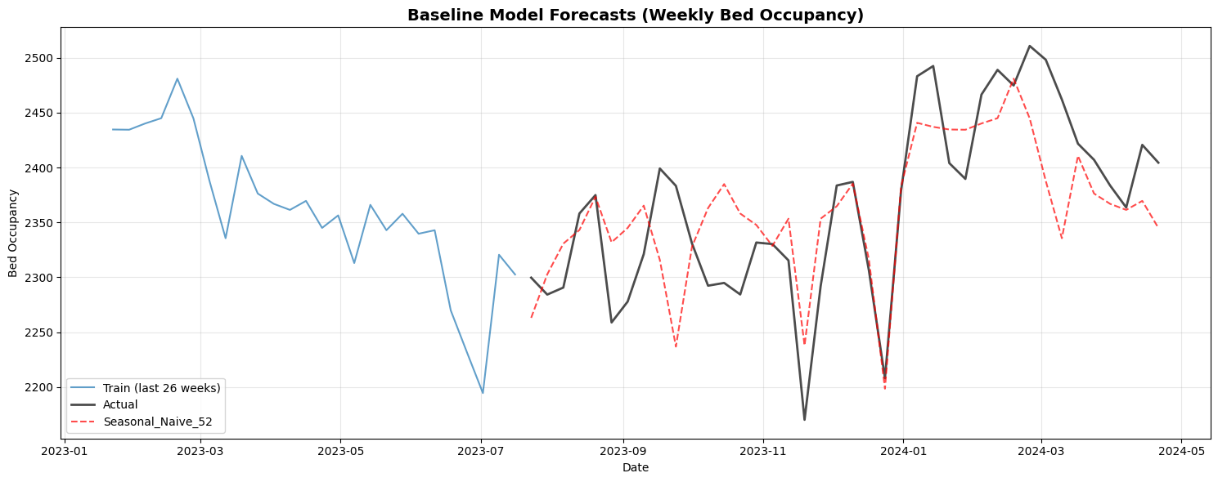
Strong 52-Week Seasonality Dominates
📈 Trend
Pandemic dip (2020-21), then recovery to ~2,350 (2023)
🔄 Seasonal
[Insert Seasonal Decomposition Plot]
52-week annual cycle (winter peaks, summer troughs)
📊 Irregular
COVID waves, random variation
💡 Key Insight: Annual seasonality explains most of the variation

Slide 5
From Simple Baseline to Deep Learning
Seasonal Naive
SARIMAX
Structural
VAR
LSTM
Baseline
Classical
State-Space
Multivariate
Deep Learning
Same week last year
ARIMA + seasonality + external factors
Explicit trend + seasonal components
Joint dynamics with COVID %
Neural network for sequences
← Simpler More Complex →

Slide 6
Rolling Forecast with Adaptive Retraining
Training: 157 weeks (80%)
Test: 40 weeks (20%)
2020
2021
2022
2023
2024
Key Parameters
• Train/Test Split: 80/20
• Forecast Horizon: 4 weeks
• Retraining: Every 2 weeks + error-triggered
💡 Simulates real-world deployment conditions

Slide 7
Model Comparison: Test Set Performance
Model | MAE (%) | RMSE (%) | Bias (%) | Rank
Structural ★ | 1.75 | 2.21 | -0.04 | 1
Baseline (SN52) | 1.81 | 2.35 | -0.22 | 2
LSTM | 1.97 | 2.31 | +0.47 | 3
SARIMAX | 2.07 | 2.59 | -0.40 | 4
VAR | 2.97 | 3.83 | +1.30 | 5
Errors shown as % of mean occupancy (~2,254 beds)
✅ All models achieve < 3% error = Excellent performance

Slide 8
What We Learned
📊 Strong Seasonality Dominates
🏆 Structural Model Wins
52-week pattern explains most variation "Same week last year" is surprisingly accurate
Best accuracy + near-zero bias Directly models trend + seasonality
⚠️ Complexity ≠ Accuracy
📈 External Factors: Modest Impact
VAR multivariate approach underperformed LSTM showed no clear advantage
Flu rates and weather provide marginal improvement Internal patterns dominate

Slide 9
What This Means for Hospital Operations
✓ Recommended: Structural Model
Applications
Application | How It Helps
Nurse Scheduling | Plan staffing 4-8 weeks ahead
Resource Planning | Anticipate supply needs
Budget Forecasting | Project labor costs
Surge Alerts | Flag high-risk weeks
• 1.75% MAE (~41 beds average error)
• Near-zero bias (well-calibrated)
• Confidence intervals for planning
💡 Tip: Keep Seasonal Naive as sanity check

Slide 10
Summary & Future Directions
Key Findings
Hospital bed occupancy is highly forecastable (~2% error) Strong 52-week seasonality is the dominant pattern
Structural State-Space • Best accuracy (1.75% MAE) • Near-zero bias • Interpretable components
Future Directions
Explore new features (ED admissions)
Ensemble methods: Combine model forecasts for improved robustness
Real-time deployment: Clean up code. Build a production pipeline with automated data ingestion and retraining
Broader Lesson
"Model complexity doesn't guarantee better forecasts.
Understanding your data's fundamental patterns matters more than algorithmic sophistication."

Slide 11
References — Thank You!
Data Sources
1. U.S. Department of Health and Human Services. COVID-19 Reported Patient Impact and Hospital Capacity. healthdata.gov.
https://healthdata.gov/Hospital/COVID-19-Reported-Patient-Impact-and-Hospital-Capa/anag-cw7u/about_data
2. Centers for Disease Control and Prevention. FluView Interactive. Accessed via Delphi Epidata API. cdc.gov/fluview/overview/fluview- interactive.html
3. National Oceanic and Atmospheric Administration. Climate Data Online. www.ncdc.noaa.gov/cdo-web/
Other References
4. Hyndman, R.J., & Athanasopoulos, G. (2021). Forecasting: Principles and Practice, 3rd ed. OTexts.
5. Harvey, A.C. (1990). Forecasting, Structural Time Series Models and the Kalman Filter. Cambridge.
6. Welton JM. Hospital nursing workforce costs, wages, occupational mix, and resource utilization. J Nurs Adm. 2011 Jul-Aug;41(7-8):309-14. doi: 10.1097/NNA.0b013e3182250a2b. PMID: 21799362.

Slide 12
YT Link to Presentation: https://youtu.be/CnK2XfcPGgg

Slide 13
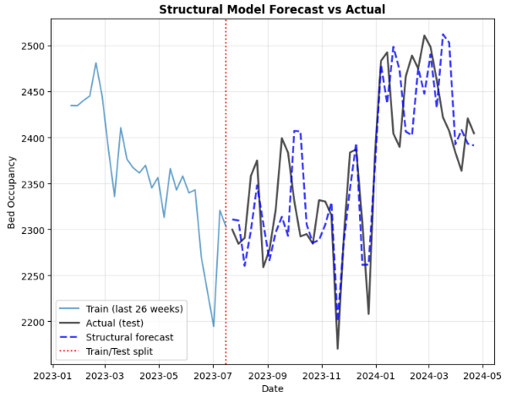
Structural Model Wins!
📈 Metrics
Best accuracy, Near zero bias
🔄 Seasonal
[Insert Seasonal Decomposition Plot]
52-week annual cycle (winter peaks, summer troughs)
📊 Interpretable
💡 Key Insight: Annual seasonality explains most of the variation

